Slide 1

WEEK 4 PROGRESS REPORT
AIRFRAME TEAM

Slide 2
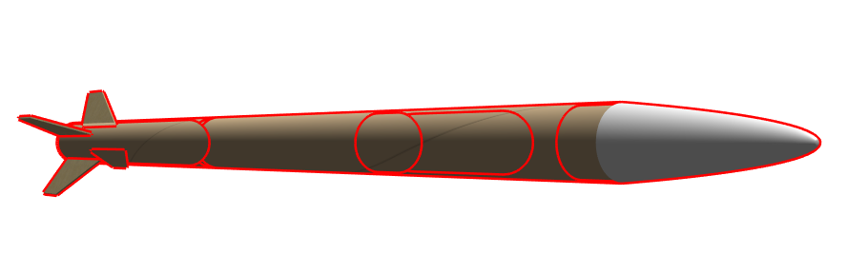
Objectives
Tasks completed
#53 Open rocket simulation using the N3 motor
#67 Test of various joining methods
#41 Use of stopper to mount motor casing into the airframe.
#68 Parachute Design.
Remaining Tasks:
Fabrication

Slide 3
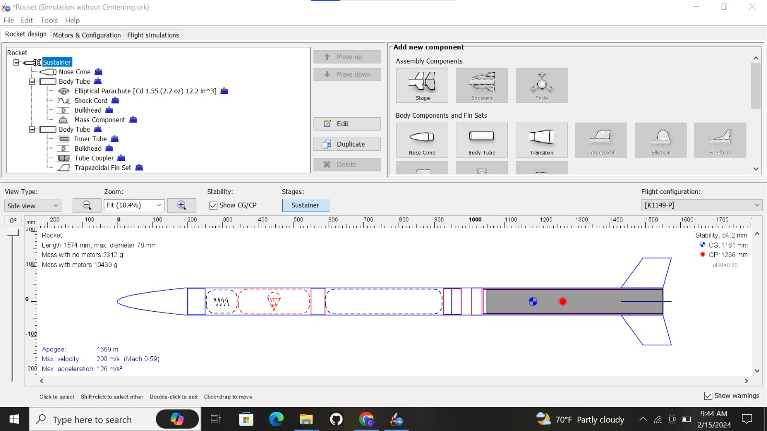
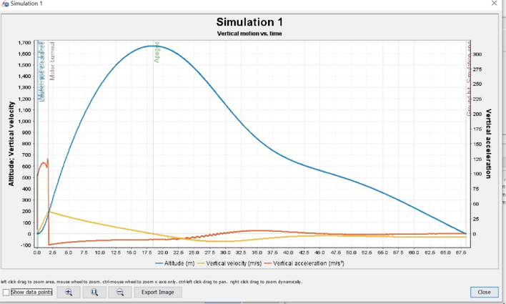
OPENROCKET SIMULATION

Slide 4
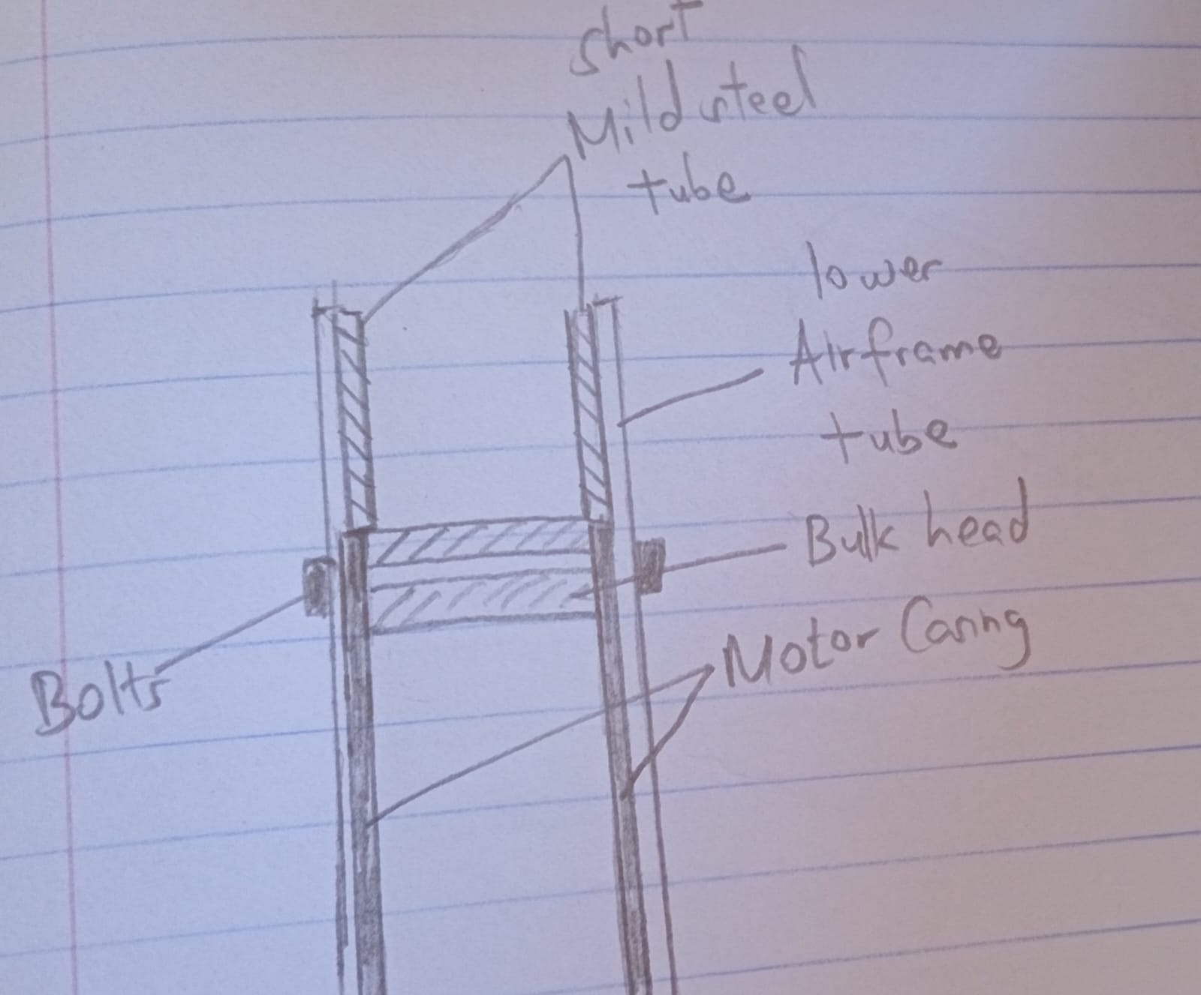
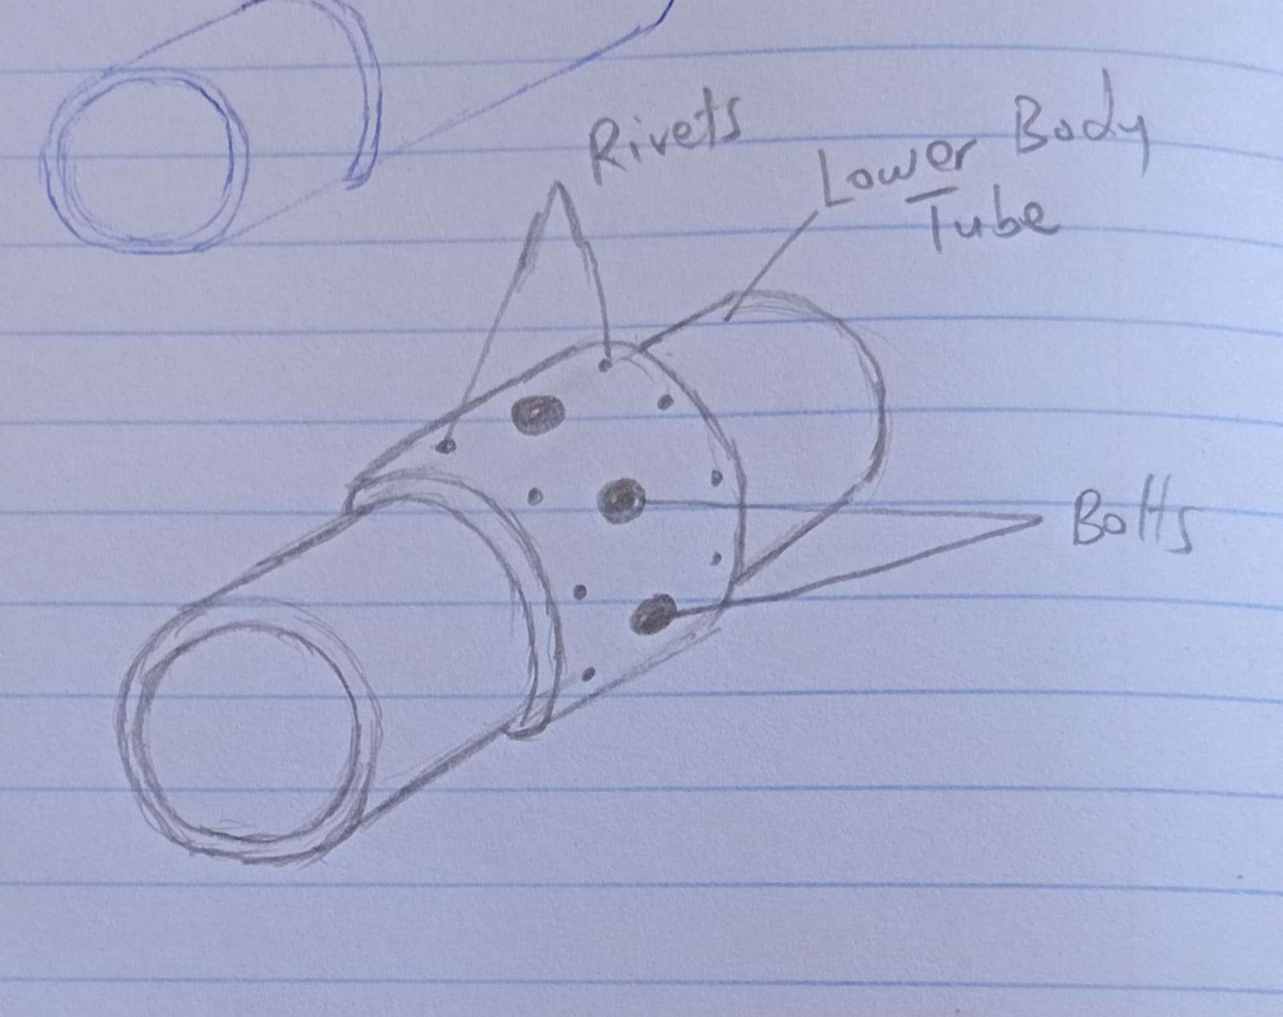
Simulation
Simulation the rocket in open motor using the N3 motor.
Low apogee of 1200m
Needed Apogee 1600m
Modifications :
Changing the rocket body thickness to 1mm
Finding new ways to strengthen the rocket.

Slide 5
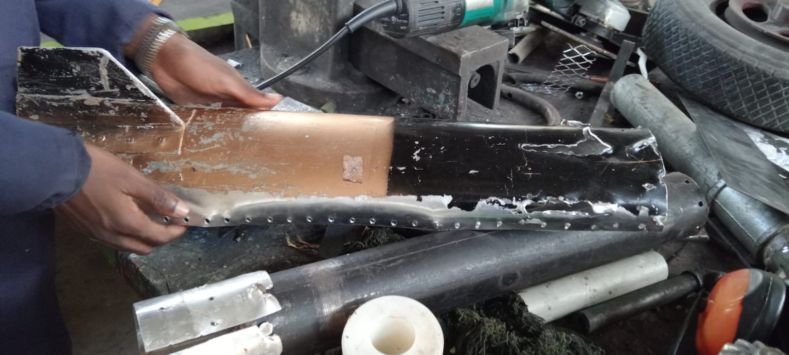
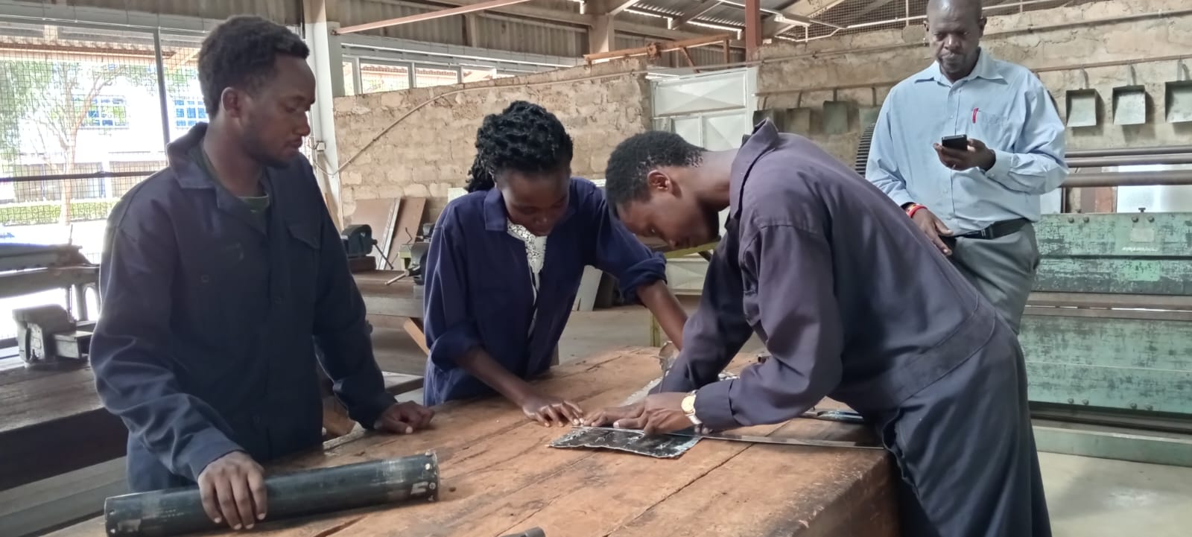
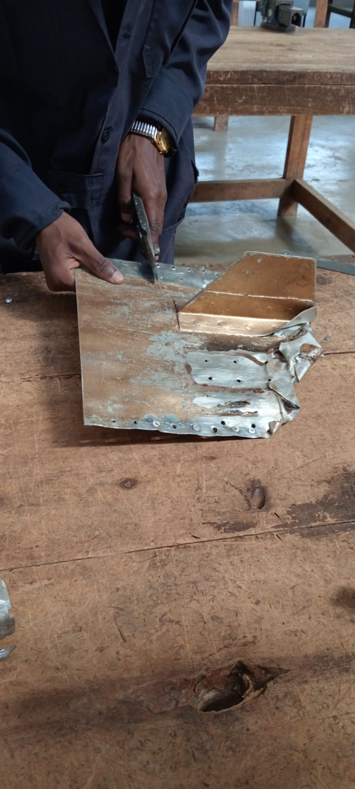
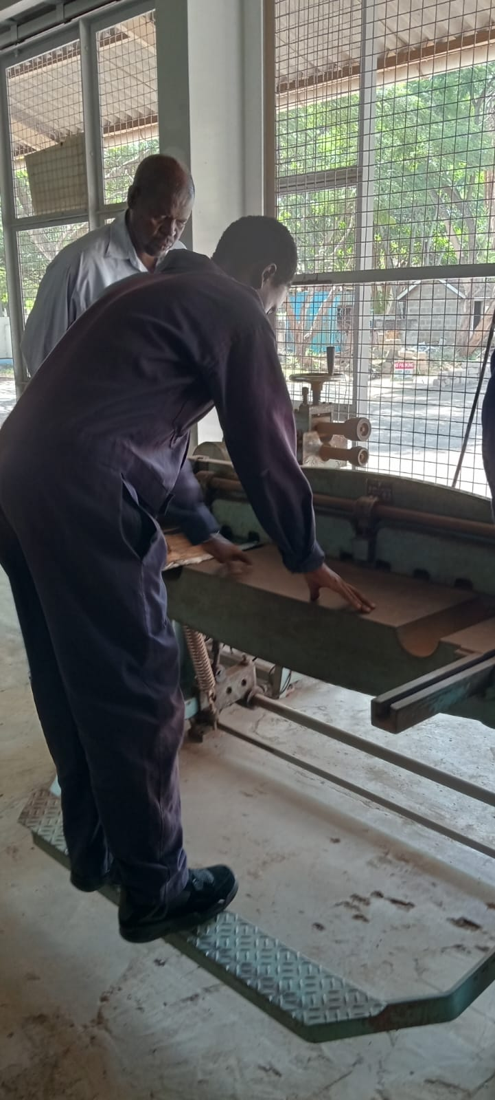
TEST SAMPLES FROM N3
The decision was made to fabricate the first body tube ourselves.
Before progressing, the strength and impact on circularity resulting from the planned joining methods were to be tested.
The material for the tests was obtained from an N3 aluminum rocket.

Slide 6
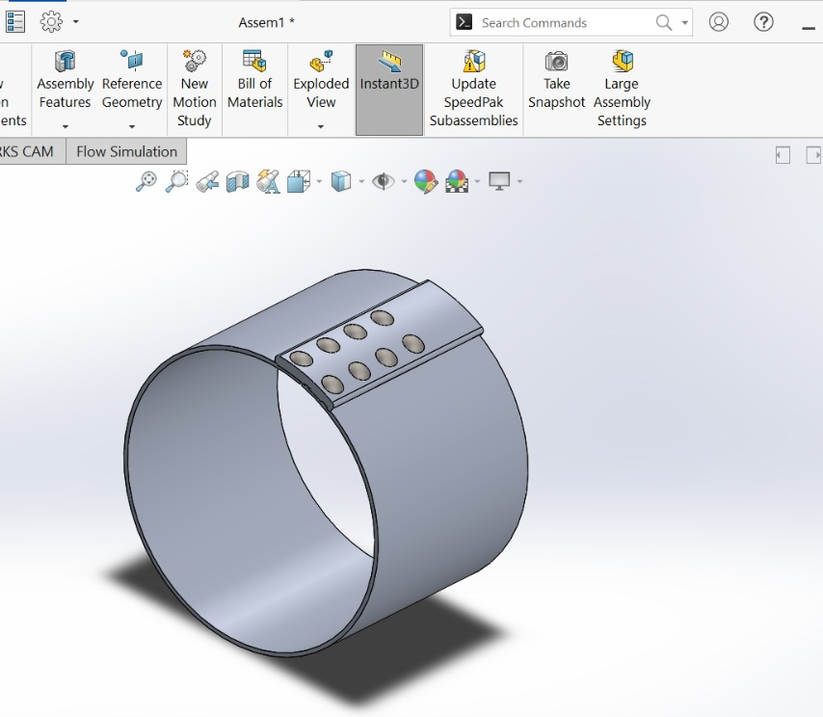
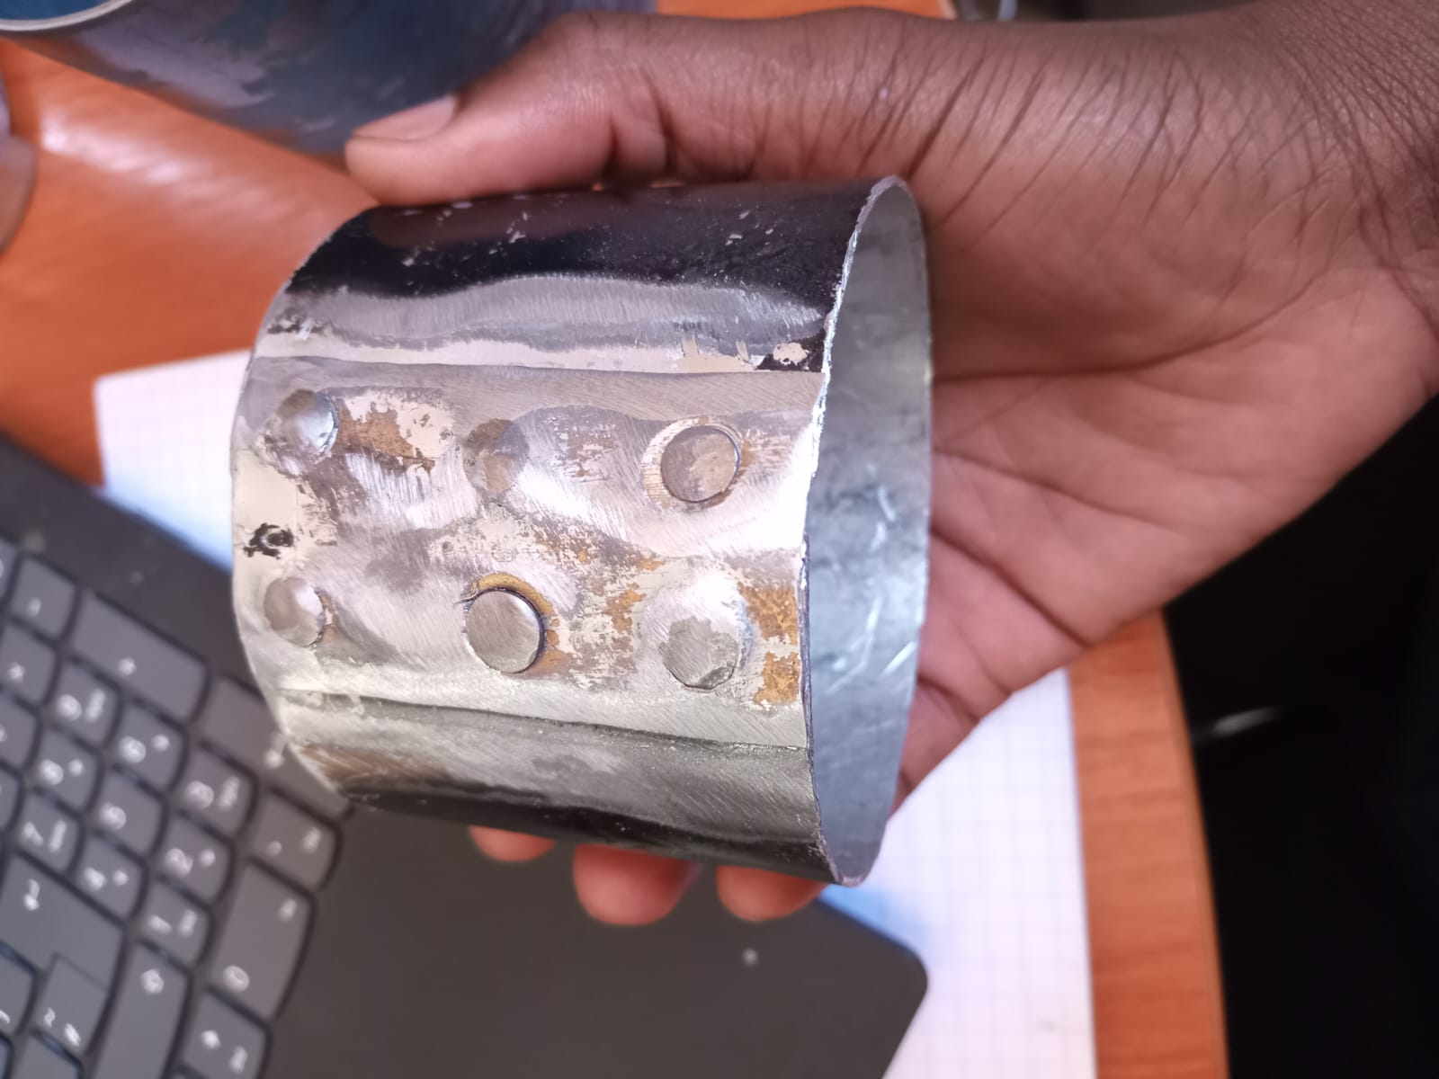
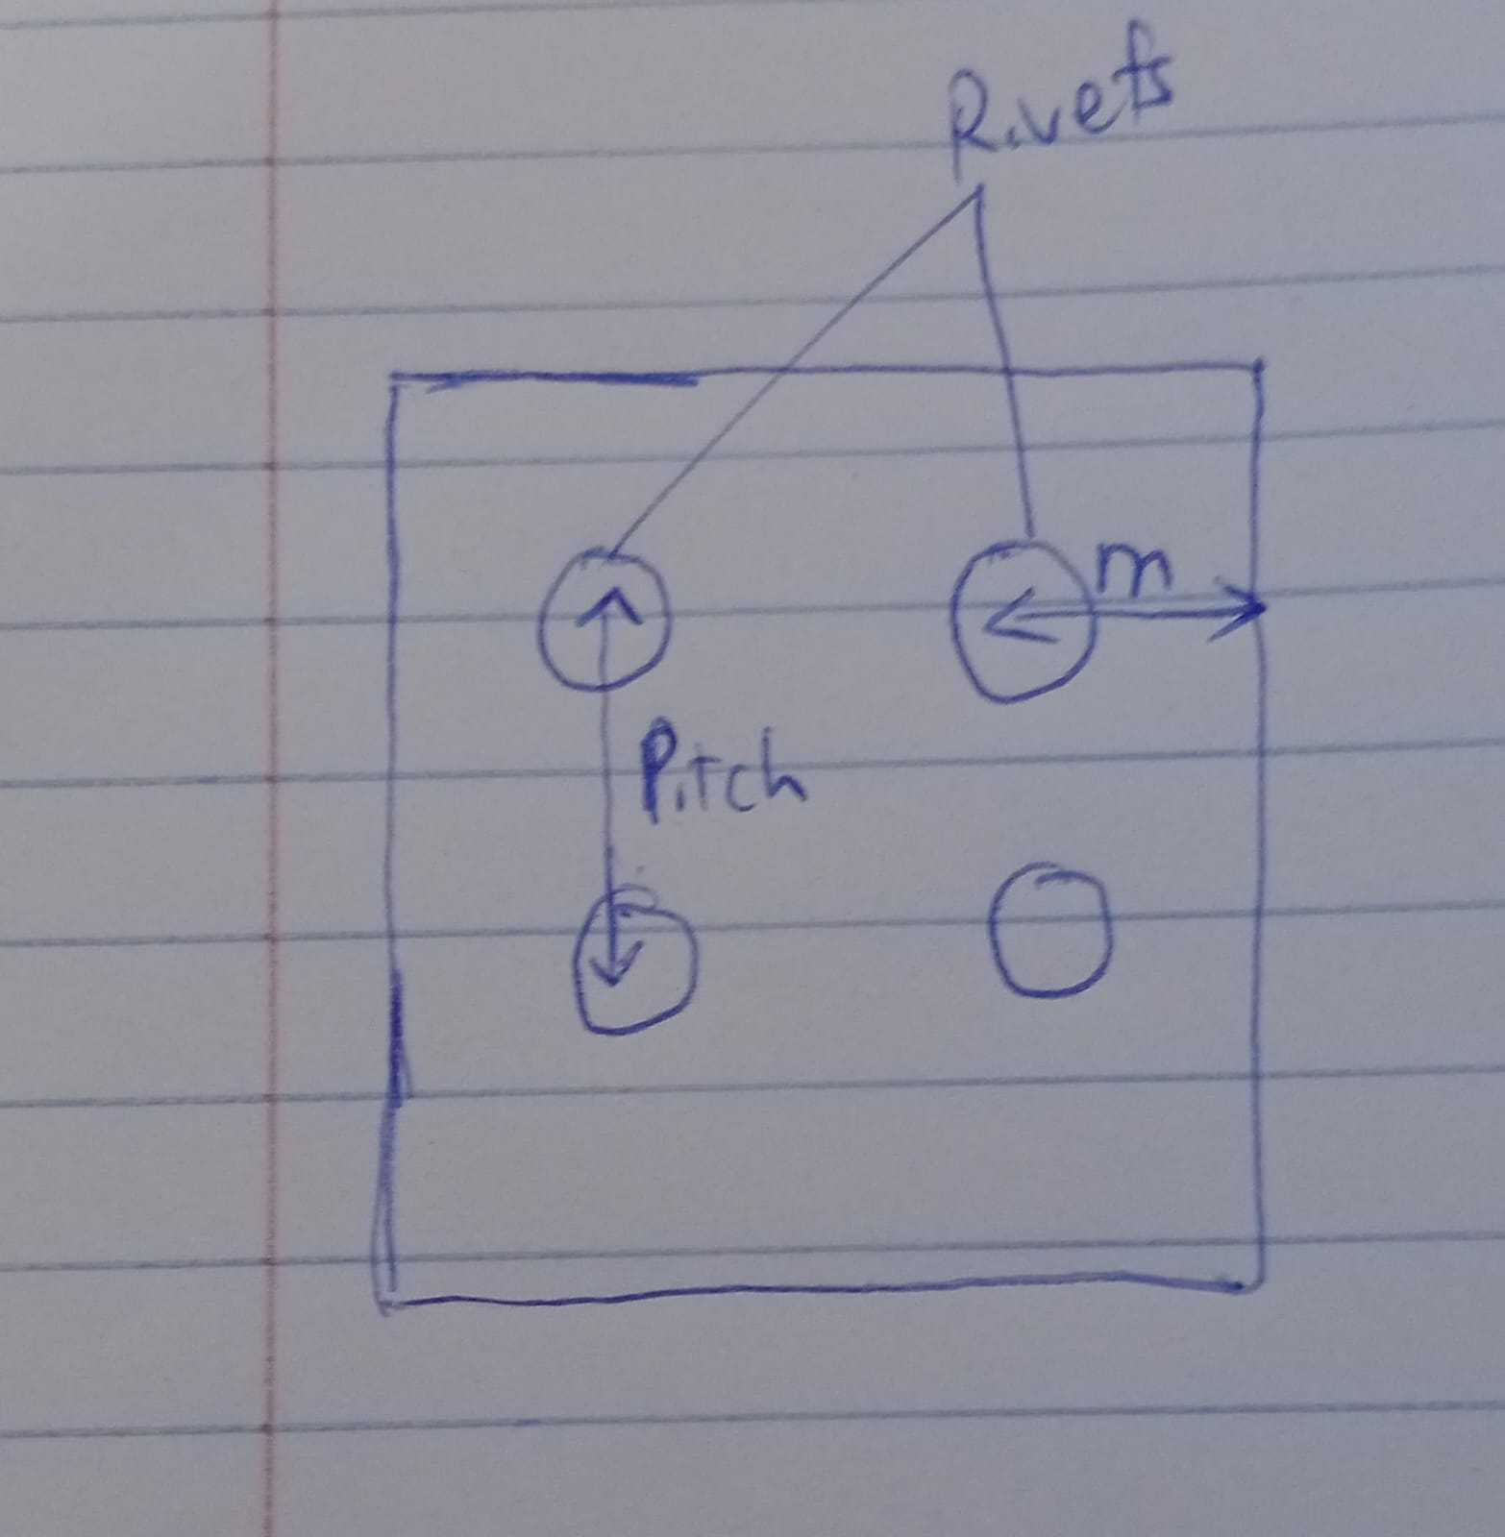

RIVETING
Were guided by A Textbook of Machine Design by R.S. KHURMI and J.K. GUPTA
We made a sample of a butt rivet joint.

Slide 7
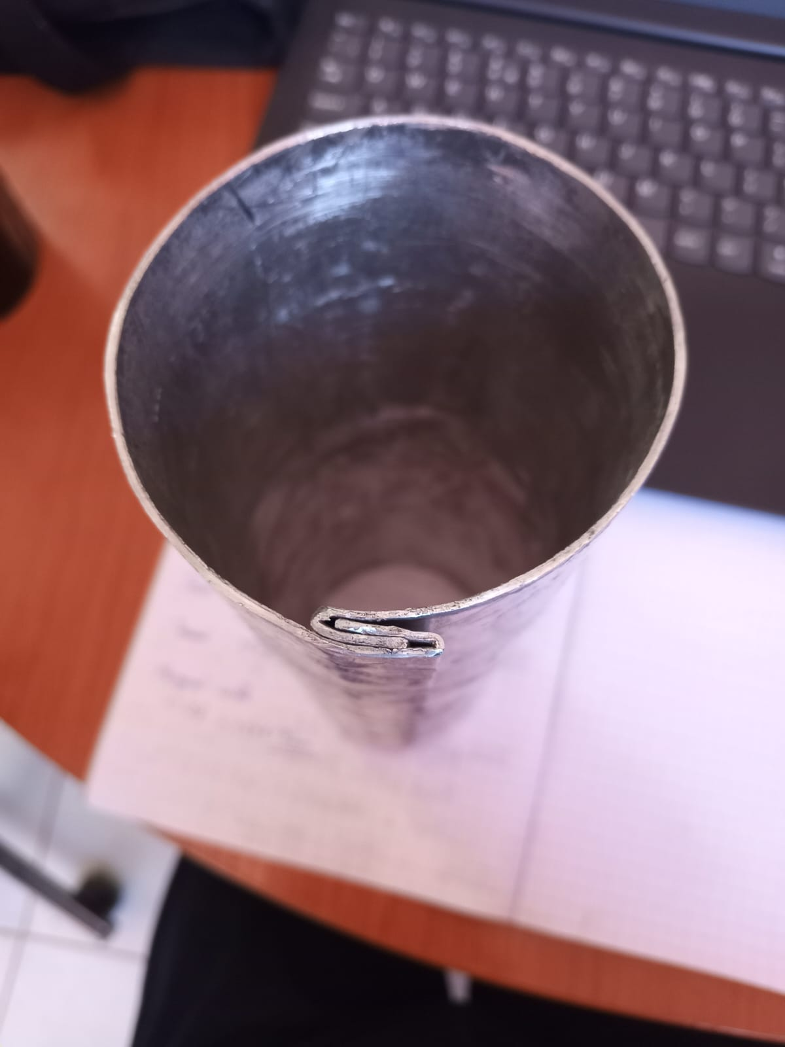
Overlap joining method
Advantages
Simplicity in Construction
Disadvantages
Added weight (results to imbalance)
Aerodynamic impacts

Slide 8
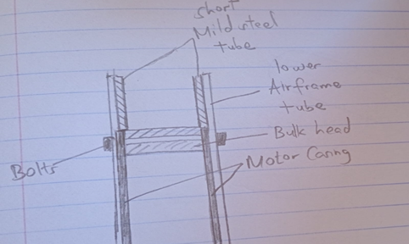
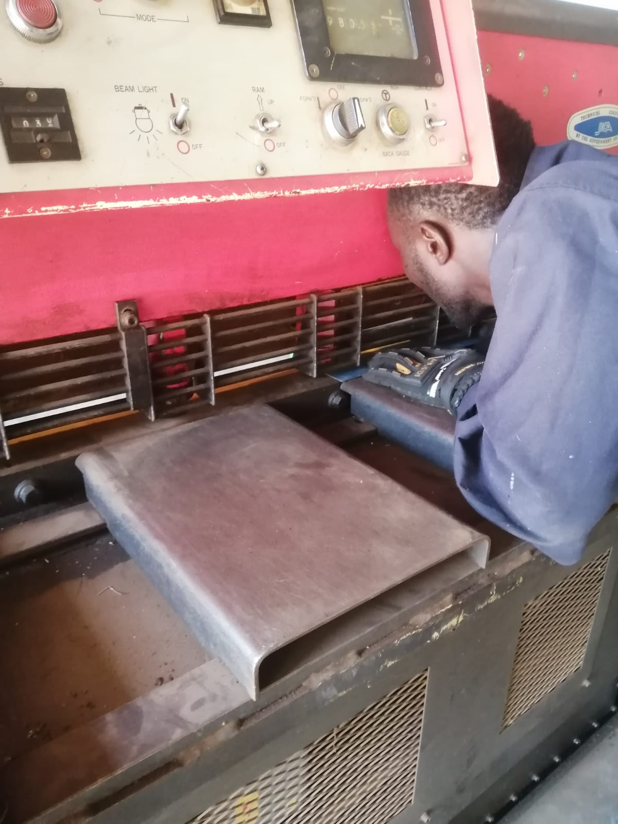
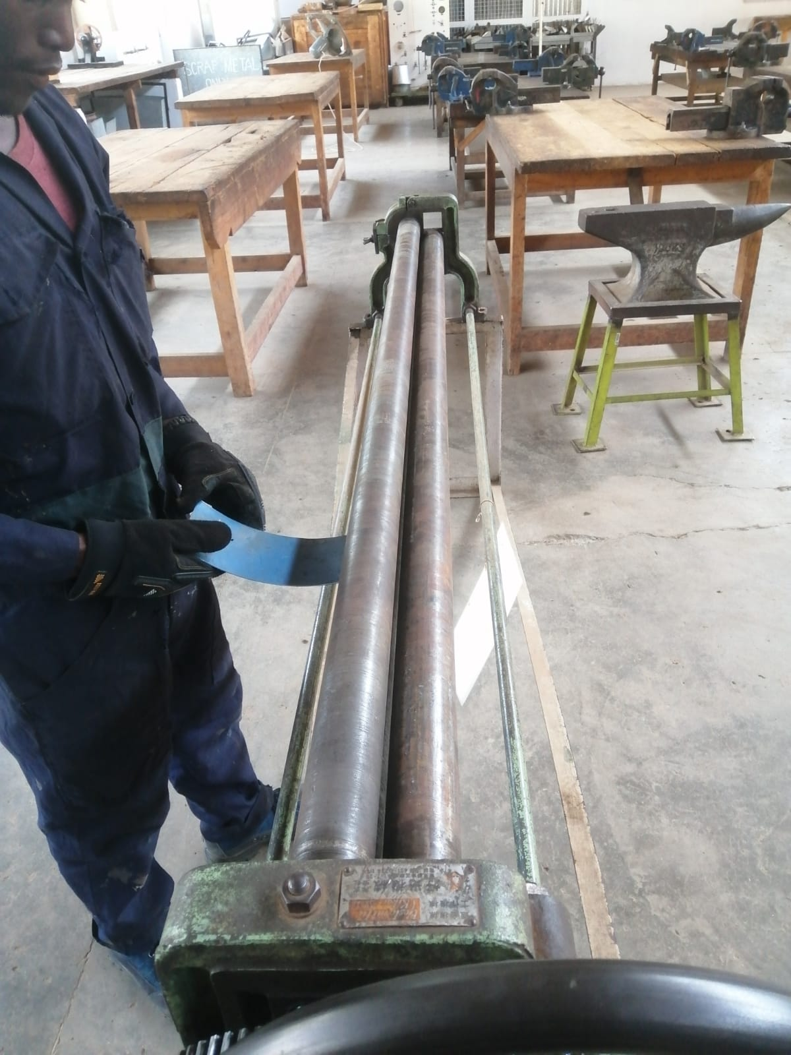
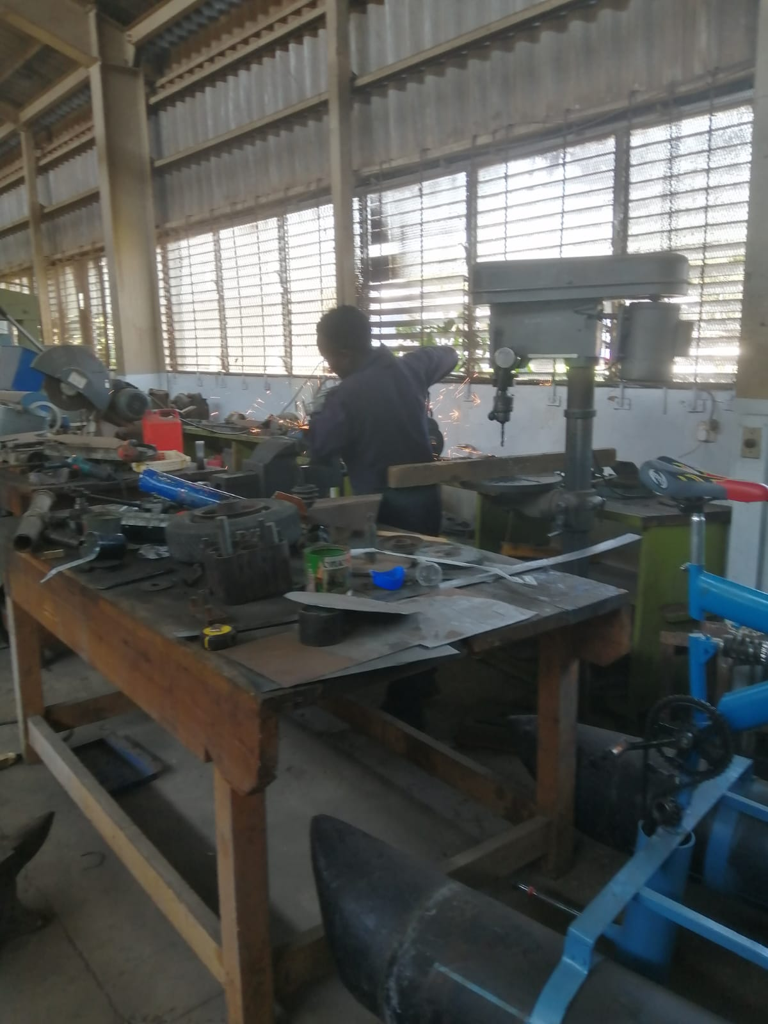
STOPPER SAMPLE FABRICATION
We fabricated the sample mild steel stopper

Slide 9
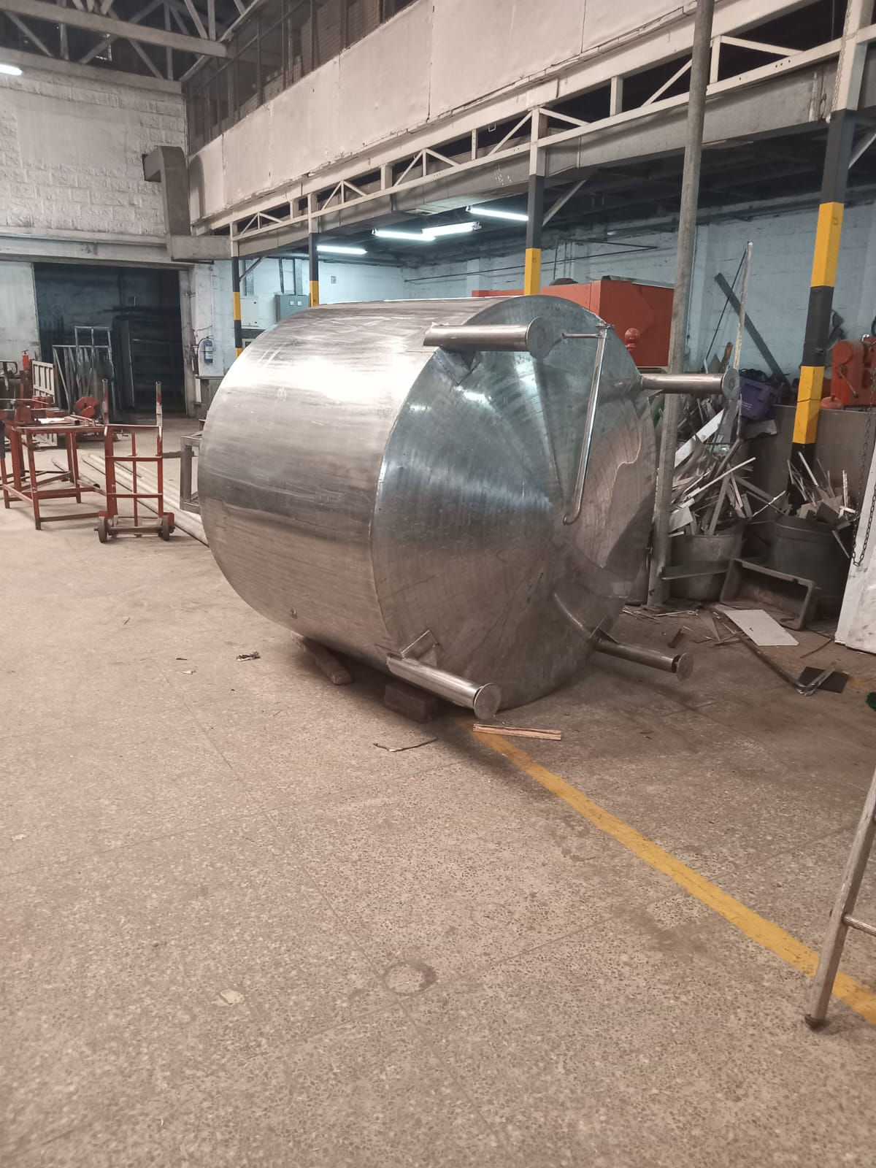
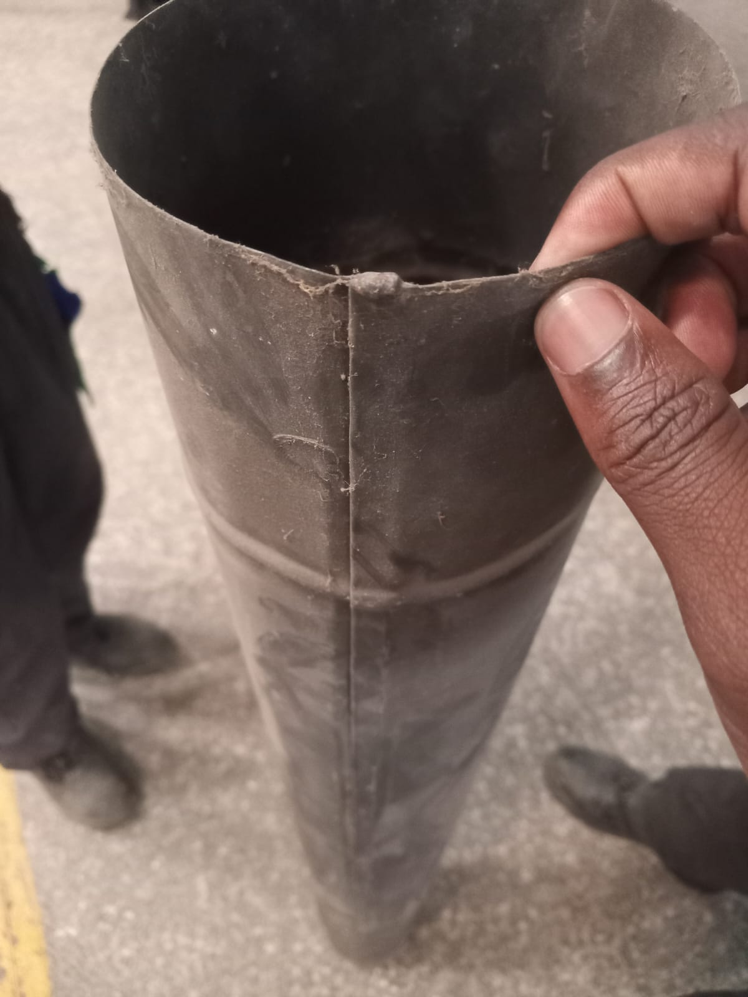
MATERIAL
One of us visited Industrial area and found an aluminum sheet 8’x4’ and a Fabricator.
Material found (6063)

Slide 10
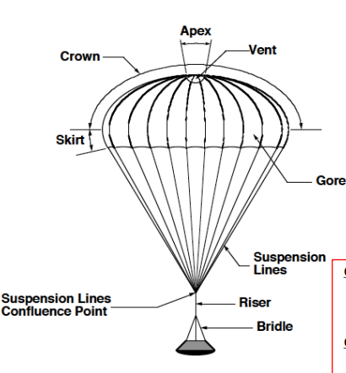
PARACHUTE DESIGN

Slide 11
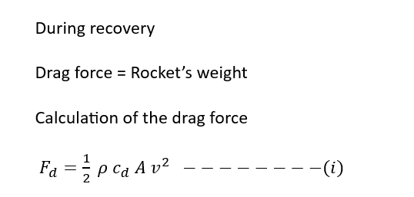
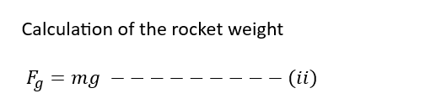
Design calculations

Slide 12
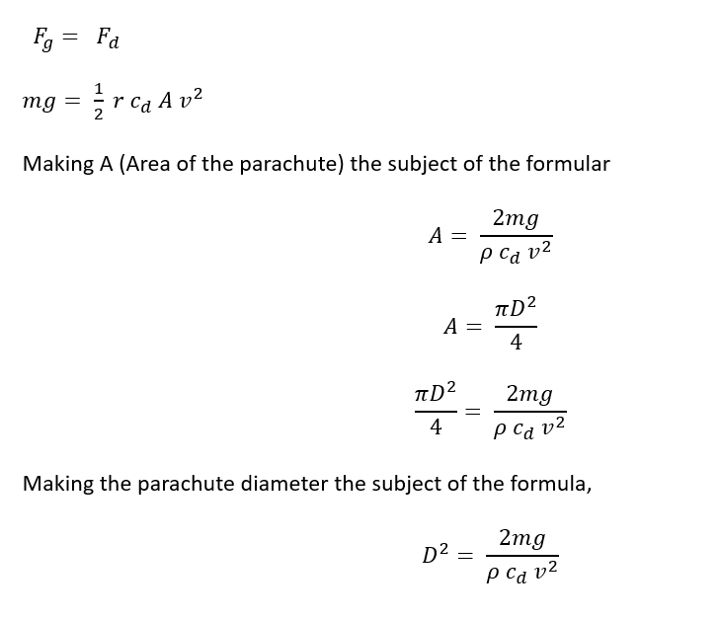
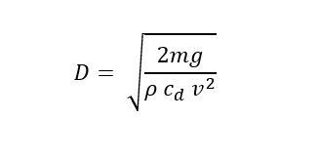
Design calculations

Slide 13
THANK
YOU

